Slide 1
Palestine Mandate and Creation of Israel

Slide 2
Palestine Mandate
Ratification of Balfour Declaration by the League of Nations set in motion a bitter conflict between Zionists and Arabs
Both sides believed in the use of any means to achieve their ends: including terrorism
Zionists had the advantage of Western backing and access to technology; Zionists followed a “take all your given and ask for more” policy
Arabs were in early stages of development and had no supportive countries; Arabs followed an “all or nothing” policy

Slide 3
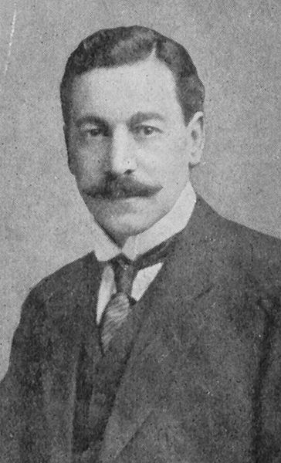
Palestine Mandate
San Remo gave Palestine over to the British and League charged Britain with oversight of fulfillment of Balfour Declaration
Jewish Agency was set up like a government within the mandate with power to administrate Zionist objectives
Arabs were not given any equivalent agency
Sir Herbert Samuel (a Jew) was appointed British high commissioner of Palestine Mandate

Slide 4
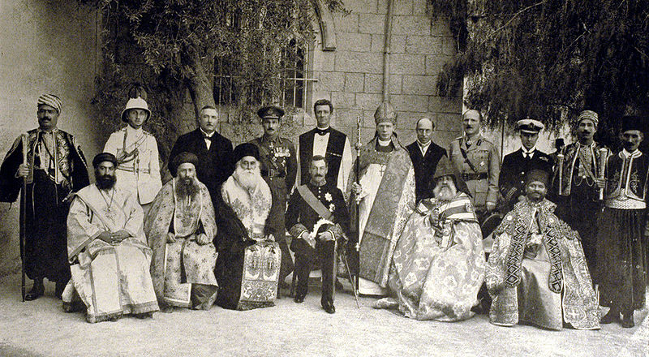
Sir Herbert’s Difficult Job
The Zionists gravely under-estimate the degree and significance of Samuel's commitment to their ideal; the Arab nationalists the extent to which Samuel, almost alone at the time among British statesmen or Zionists, perceived the reality and force of Arab opposition to Zionism, and based his policy on an awareness of the need to come to terms with rather than repress or merely ignore that opposition

Slide 5
Early Arab Protests
Despite Jewish roots, Sir Herbert leaned over backwards to be fair and just to the Arab population
He appointed Haj Amin Al Husayni as Grand Mufti of Jerusalem, who would provide leadership and keep charge of waqf ($300,000 a year)
ironically al-Husayni later proved a thorn in the side of the British administration in Palestine and headed anti-British/Zionist Arab Higher Committee
Fearing Zionist objectives were overshadowing their own, the Arabs staged anti-Zionist riots in Jerusalem in 1921

Slide 6
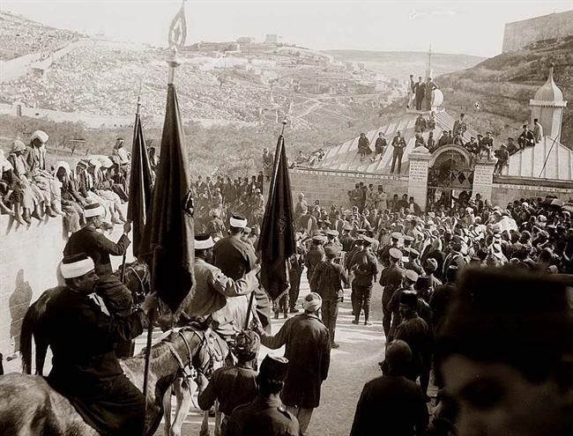
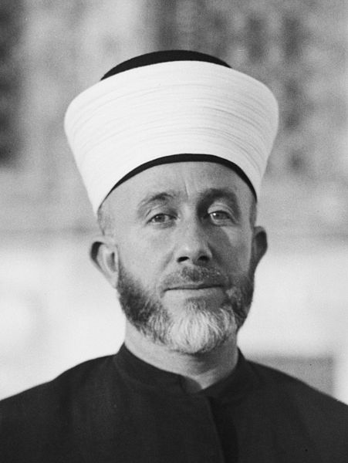
Inflammatory anti-Zionist rhetoric was being delivered from the balcony of the Arab Club. One inciter was Hajj Amin al-Husayni; his uncle, the mayor, spoke from the municipal building's balcony. The Arab mob ransacked the Jewish Quarter of Jerusalem, attacked pedestrians and looted shops and homes

Slide 7
Jewish Immigration
Occurred in waves (Aliyah)
First Aliyah 1882-1903
approximately 35,000 Jews immigrated to the south-western area of Ottoman Syria from Russia
Second Aliyah 1904-1919
40,000 Jews immigrated mainly from Russia to south-western Syria due to pogroms and anti-semitism
Third Aliyah 1919-1923
40,000 Jews, mainly from the Soviet Union
pioneers (halutzim) trained in agriculture, established self sustaining economies.
In spite of immigration quotas imposed by the British, the population of Jews reached 90,000 by end of this period.
Fourth Aliyah 1924-1929
82,000 Jews arrived, many as a result of anti-semitism in Poland and Hungary. The immigration quotas of the United States kept many of these Jews out of North America

Slide 8
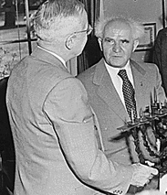
Jewish Colonial Government
Jewish Agency was under British mandate
charged with facilitating Jewish immigration to Palestine, land purchase and planning the general policies of the Zionist leadership.
It ran schools and hospitals, and formed a defense force, the Haganah.
Chaim Weizmann was the leader
Histadrut
powerful general trade union in Palestine under David Ben-Gurion
Membership grew from 4,400 in 1920 and to 8,394 members in 1922. By 1927, the Histadrut had 25,000 members, accounting for 75% of the Jewish workforce

Slide 9
Palestinian Arabs Displaced
Britain supported Jewish immigration in principle, but in reaction to Arab violence imposed restrictions.
The Zionists came to Palestine but the mandate did not put state lands at their disposal. Jewish Agency bought lands from their Arab owners at high prices.
the Arab land owners were city-dwelling businessmen who leased the land to Arab farmers
once sold, the Arab farmers were evicted from the land and forced to seek jobs in cities as unskilled laborers
Jews brought agricultural technology against which the remaining neighboring Arab farmers could not compete

Slide 10
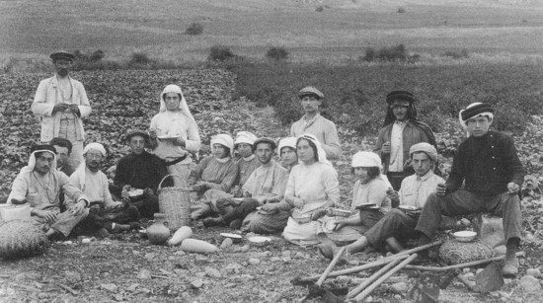
Many of Jewish settlers were from Communist countries and brought socialist ideas
formed kibbutz collective farm with common mess hall and nursery. All profits went to treasury and each individual was allocated a certain amount of spending money
Pretty soon enough land around Arab villages were bought and settled by modern Jewish kibbutzim that the villages could no longer thrive
displaced Arab farmers went to the cities only to find that most industries were run by Jews reluctant to hire Arabs

Slide 11
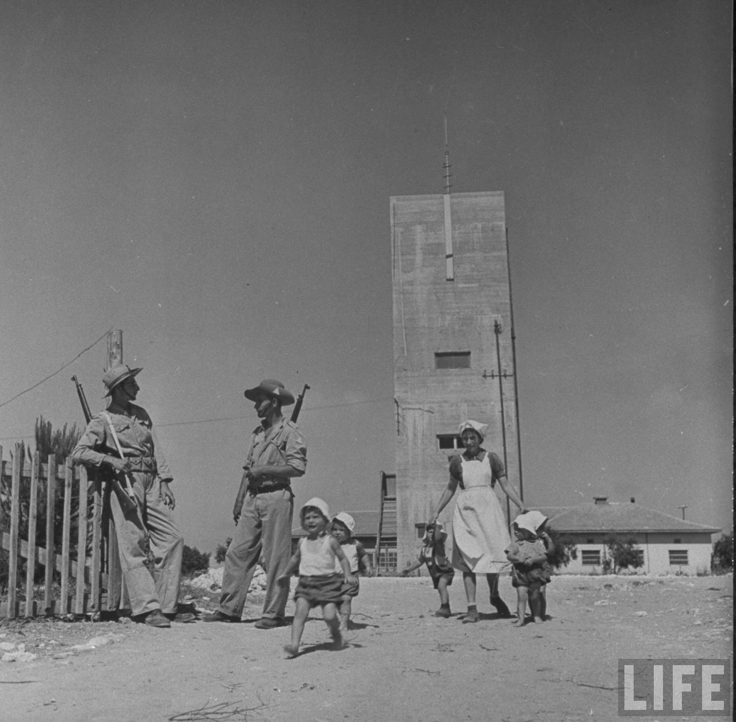

Slide 12
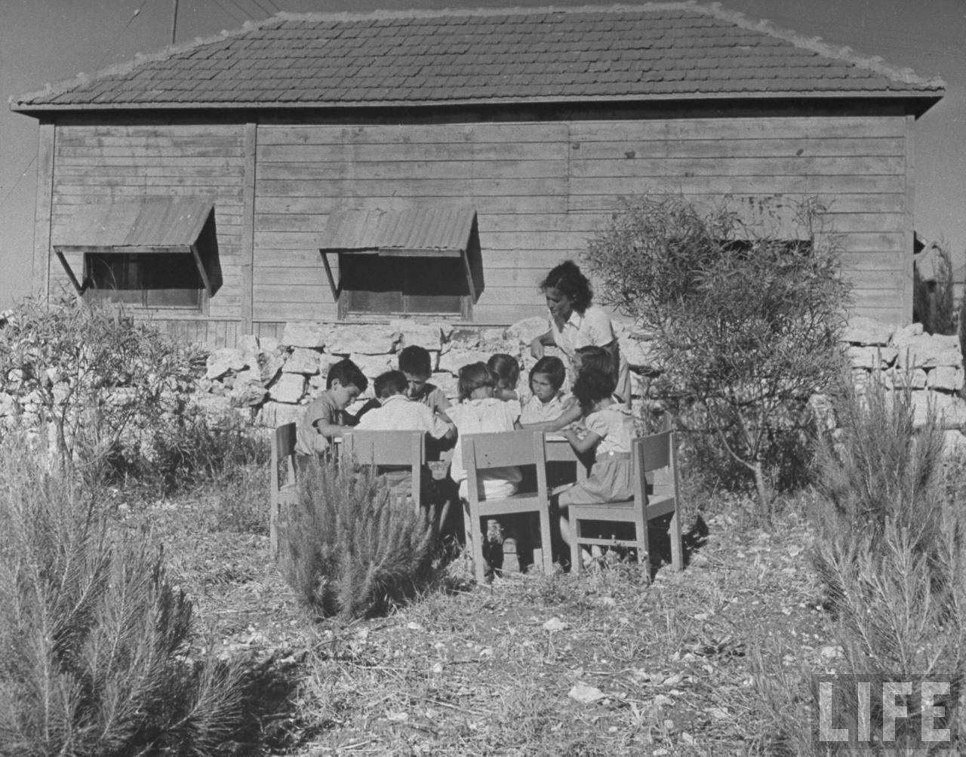

Slide 13
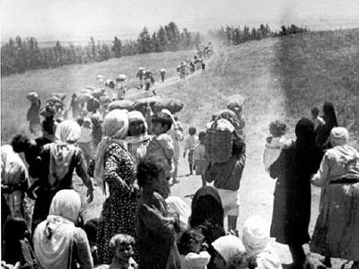

Slide 14
Arab Resentment
Unlike the Jews, the Arabs were poorly organized and represented.
Arab Higher Committee represented the collective political parties of Arab Palestine but they were ineffective and sporadic
Supreme Muslim Council was a religious judiciary body but not supposed to engage in political affairs
Mufti Haj Amin al-Husayni headed both
it was clear he was both anti-Zionist anti-British
Arabs received no stream of contributions from all over the world and felt powerless to competed with the Zionists
In their frustration, it seemed about the only thing they could do was to protest and start riots

Slide 15
1929 Palestine Riots
Began initially over access to the Wailing Wall 1928
Jews built a partition (mechitza) between men and women during religious ceremony, when Arabs protested, citing laws held over from Ottomans forbiding Jews to make construction on Temple Mount
British riot police disperse Jews, tear down mechitza
Mufti al Husseini, the of Jerusalem exploited the incident by distributing leaflets which claimed that the Jews were planning to take over the al-Aqsa Mosque.
A year later, August 16, 1929, after an inflammatory sermon, a demonstration organized by the Supreme Muslim Council marched to the Wall and burnt prayer books and prayer notes left in the Wall's cracks. As the riots continued, and the next day a young Jew was stabbed and later died.

Slide 16
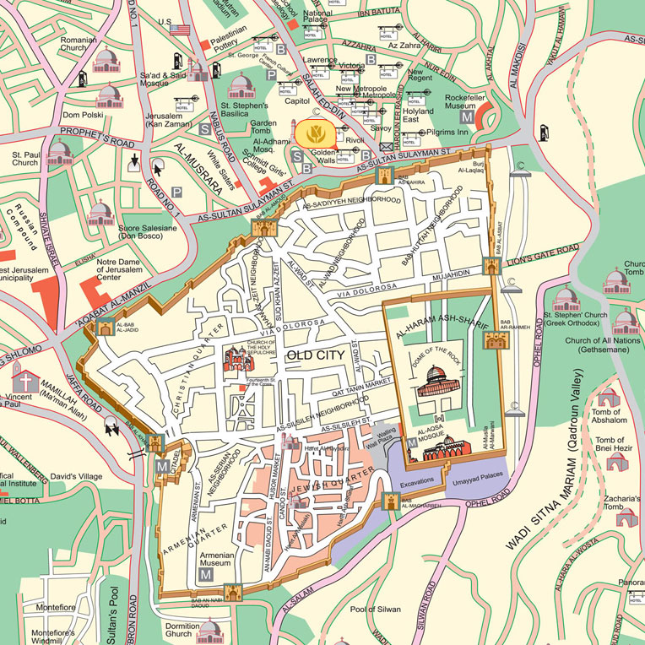

Slide 18
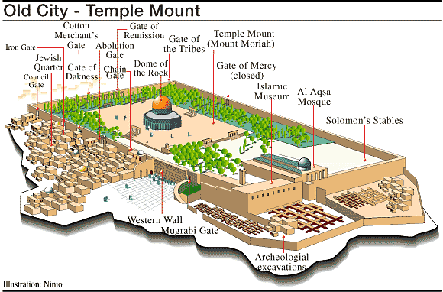

Slide 19
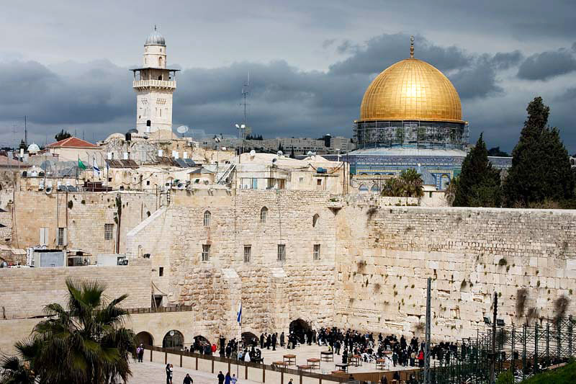
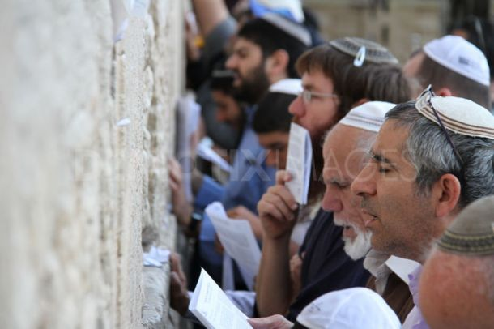

Slide 20
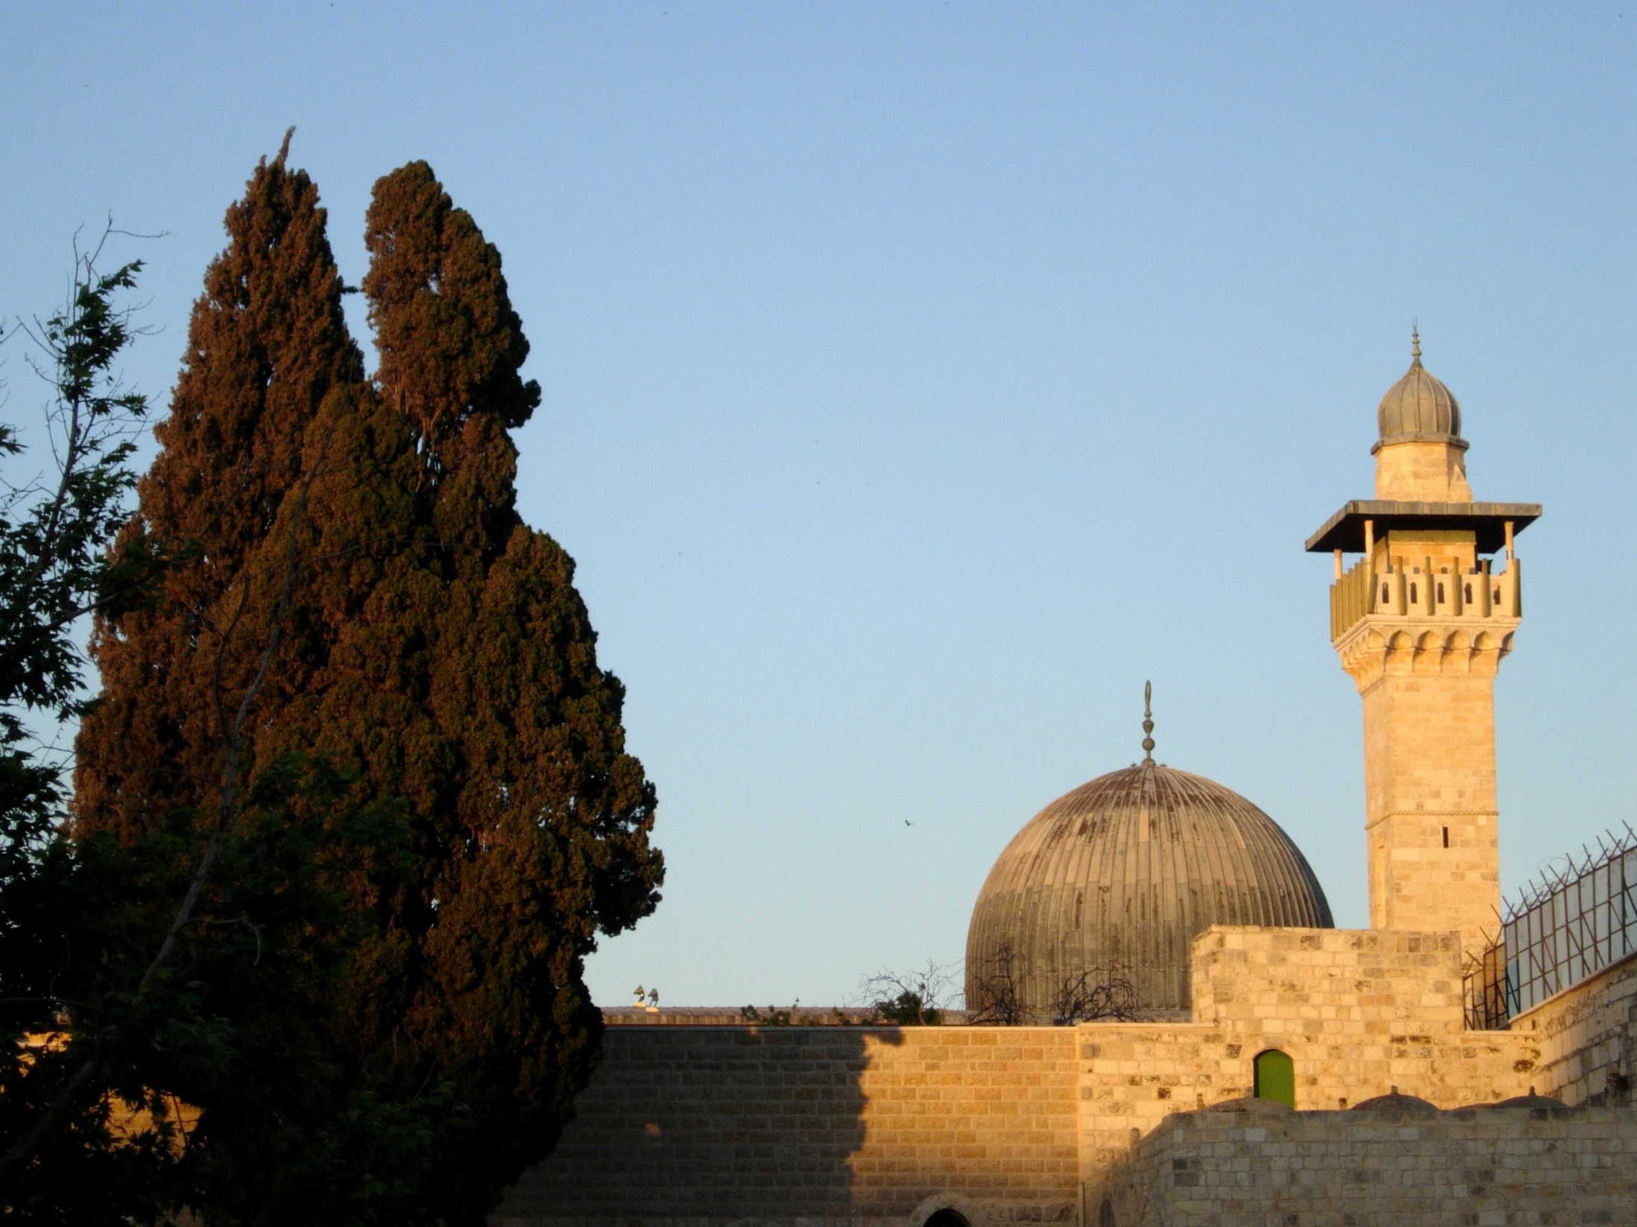

Slide 21
1929 Palestine Riots
After his funeral, Jews turned to authorities for protection, but they were either powerless or didn’t care to stop escalating violence. When Jews offered to manage their own protection, they were refused arms to do it with.
As the riots spread throughout Palestine, Arab mobs committed “pogrom” against Jews for hours until British forces could mobilize & disperse them
During the week of riots, 116 Arabs and 133 Jews were killed and 232 Arabs and 198 Jews were injured (Arab casualties were due mostly to police)

Slide 22
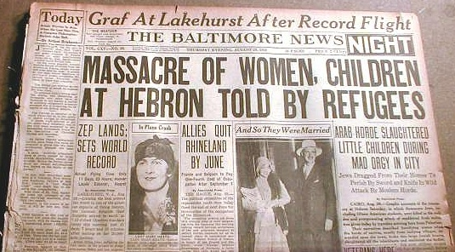
August 29, 1929

Slide 23
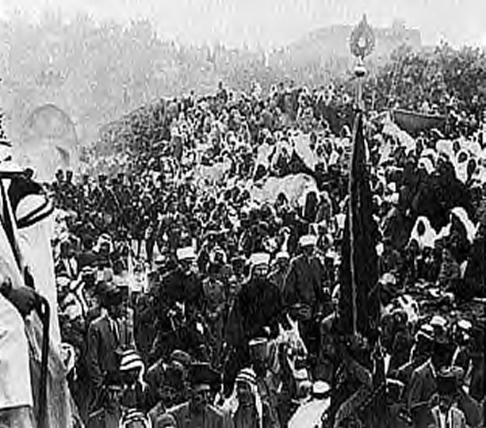
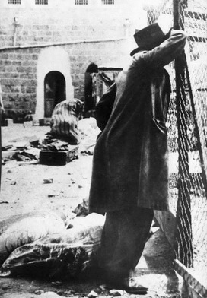
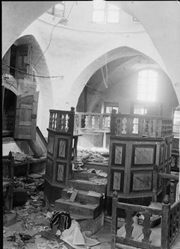

Slide 24
A British commission of inquiry concluded:
The outbreak was from the beginning an attack by Arabs on Jews for which no excuse in the form of earlier murders by Jews has been established.
The outbreak was not premeditated.
It was a vicious attack by Arabs on Jews accompanied by wanton destruction of Jewish property. A general massacre of the Jewish community at Hebron was narrowly averted. In a few instances, Jews attacked Arabs and destroyed Arab property. These attacks, though inexcusable, were in most cases in retaliation
the Mufti had a desire to confront the Jews and to mobilize Moslem opinion on the issue of the Wailing Wall. He had no intention of utilizing this religious campaign as the means of inciting to disorder.
little blame can be attached to the Mufti in which some Jewish religious authorities also would not have to share. ..... After the disturbances had broken out the Mufti co-operated with the Government in their efforts both to restore peace and to prevent the extension of disorder.
The fundamental cause ... is the Arab feeling of animosity and hostility towards the Jews consequent upon the disappointment of their political and national aspirations and fear for their economic future. ... The feeling as it exists today is based on the twofold fear of the Arabs that by Jewish immigration and land purchases they may be deprived of their livelihood and in time pass under the political domination of the Jews.

Slide 25
White Paper
British began to rethink Palestine policies
In response, British Colonial Secretary Passfield issued a White Paper in 1930:
limited official Jewish immigration to a much greater degree.
The paper's tone was decidedly not pro-Zionist since several of its institutions were severely criticized,
including the Histadrut (General Federation of Labor) and the Jewish Agency, which both promoted Jewish employment of only Jewish labor.
found this Zionist policy damaging to the economic development of the Arab population.
the development of a Jewish National Home in Palestine is a consideration, which will have continued support, but is not central to mandate governance.
the British intend to fulfill their mandate obligations to both Arabs and Jews, and they would resolve any conflicts that might surface as a result of their respective needs.

Slide 26
Reaction to White Paper
Among Zionists, it was one of resentment: the British had begun by fulfilling the Balfour Declaration, now they were backing out
Chaim Wiseman was forced to resign because of his “pro-British” views
Jewish protests erupted throughout the West
Prime Minister McDonald tried to soften the blow by reassuring jews of Britain's commitment to Balfour
Now the Arabs began protesting

Slide 27
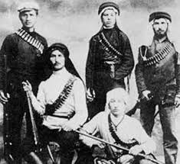
Irgun
In 1931, members of the Haganah who objected to Jewish Agency’s policy of restraint separated and formed Irgun
“every Jew had the right to enter Palestine; only active retaliation would deter the Arabs; only Jewish armed force would ensure the Jewish state".
Irgun would resort to acts of terrorism

Slide 28
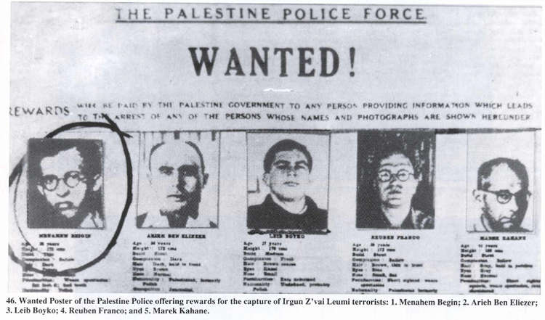

Slide 29
The Nazis Heat Up Things
By the mid 1930’s, there developed a sense of urgency in Palestine. Pro-Nazi broadcasts were heard where Mohammad Amin al-Husayni helped to insure the spread of Nazi ideas in the Arabic language
in 1935 the Nuremberg Laws made German Jews (and later Austrian and Czech Jews) stateless refugees. Similar rules were applied by the many Nazi allies in Europe
a new wave of 250,000 immigrants arrived; the majority of these arrived between 1933 and 1936, after which increasing restrictions on immigration by the British made immigration clandestine and illegal, called Aliyah Bet. The Fifth Aliyah was again driven mostly from Eastern Europe as well as professionals, doctors, lawyers and professors, from Germany.

Slide 30
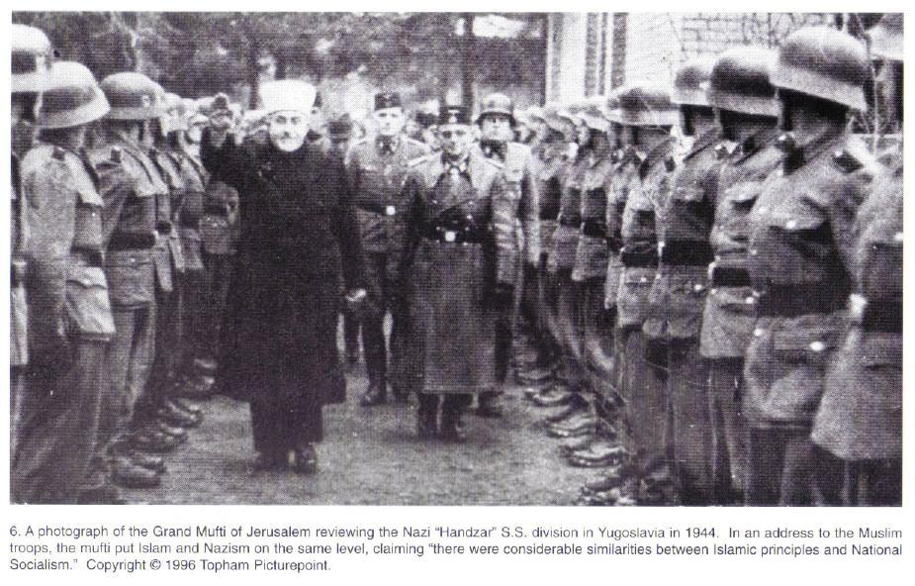

Slide 31
Palestine Violence Resumes
Renewed serious clashes between Arabs and Jews broke out in 1936 and were to last three years.
In response Britain sent Peel Commission to evaluate the situation in the fall of 1936.
The Commission was charged with determining the cause of the riots, and judging the merit of grievances on both sides.
Chaim Weizmann made a speech on behalf of the Jews.
The Mufti of Jerusalem, Hajj Amin al-Husseini, testified in front of the commission, opposing any partition of Arab lands with the Jews. He demanded full cessation of Jewish immigration.
Although the Arabs continued to boycott the Commission officially, there was a sense of urgency to respond to Weizmann's appeal to restore calm.

Slide 32
Peel Report
Peel Commission concluded that Britain could not “both concede the Arab claim to self-government and secure the establishment of the Jewish National Home”
Recommended partitioning Palestine into separate Jewish and Arab states with Jerusalem and Bethlehem under separate and direct administration of the mandate
it called for a population exchange to get Jews out of Arab and Arabs out of Jewish areas.

Slide 33
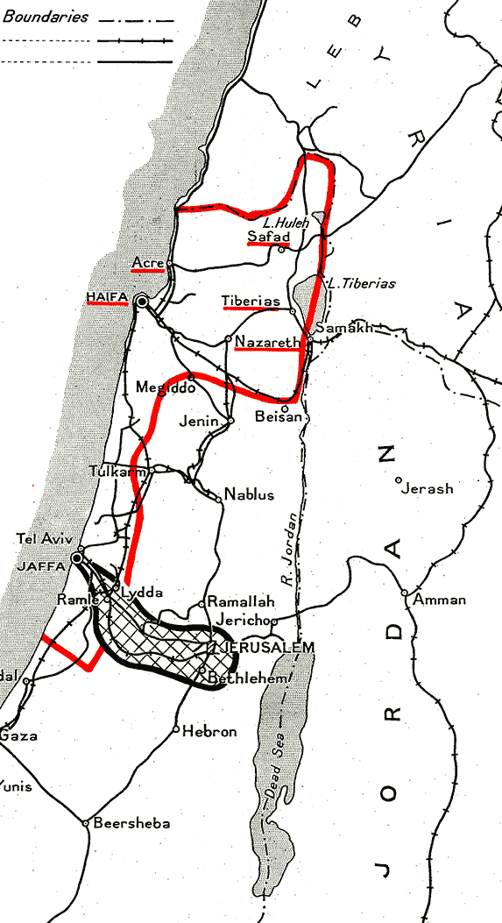
The report recommended that the Mandate be eventually abolished — except in a "corridor" surrounding Jerusalem, and the land under its authority be apportioned between an Arab and Jewish states.
The population exchange, if carried out, would have involved the transfer of up to 225,000 Arabs and 1,250 Jews

Slide 34
Rejection of Peel
The Peel Report was met with hostile response by both Arabs and Jews
There were a number of Zionists, among them Weizmann, who favored it because it recognized Zionist objectives but the Twentieth Zionist Congress voted in 1937 to reject it as infringing upon the guarantees made under Balfour
King Abdullah of Transjordan strongly recommended acceptance but the Arab High Committee was against it.
In 1937, the Pan-Arab Congress voted to reject it

Slide 35
Another Missed Opportunity
Ben-Gurion wrote 20 years later: "Had partition [referring to the Peel Commission partition plan] been carried out, the history of our people would have been different and six million Jews in Europe would not have been killed---most of them would be in Israel"

Slide 36
Renewed Violence
again Arab violence erupted in the region
this time British authorities clearly implicated the Mufti of Jerusalem as the instigator and sought to arrest Husayni and other extremist members of the Arab Higher Committee
They fled to Lebanon and directed resistance from there
There was virtual civil war in Palestine and the Haganah was given permission to bear arms
the underground Irgun became active in terrorism

Slide 37
Another White Paper
Finally in 1939, on the eve of World War II, Great Britain issued a White Paper on May 17, 1939
There was a reversal of policy in favor of the Arabs
proposed creation of independent bi-national state of Palestine in ten years
limited Jewish immigration to 75,000 in five years after which immigration would be conditional on Arab consent.
Land sale would be forbidden in most places in Palestine

Slide 38
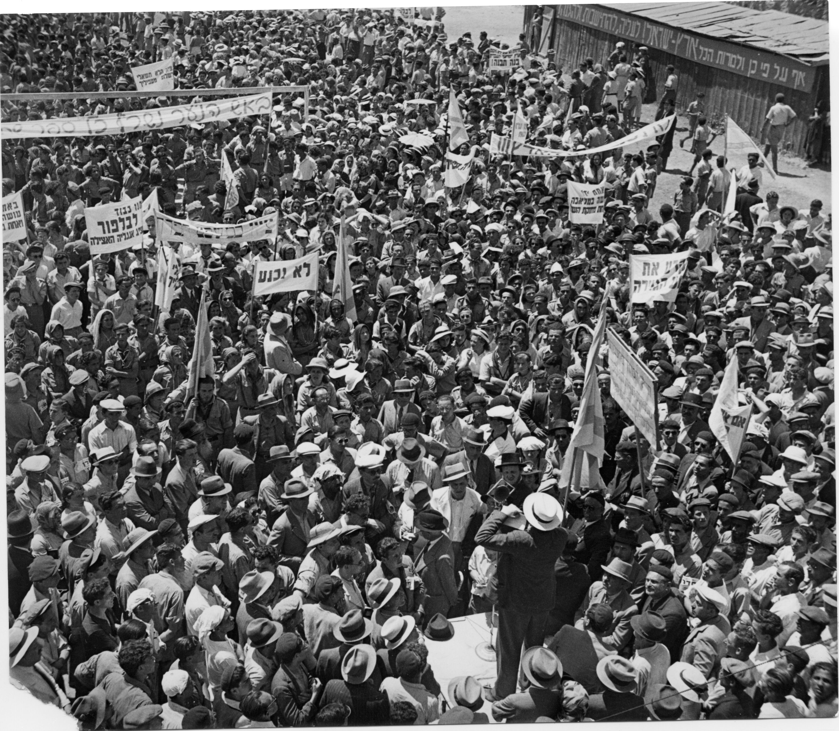

Slide 39
World War II
Ironically, the rest of the world at war brought peace to the unstable Palestine mandate:
Jews, not wishing the alternative, actively sided with the Allies
formed Jewish brigade
Ben-Gurion declared “we shall fight the White Paper as if there is no war; and we shall fight the war as if there is no White Paper
Arabs were indifferent and a mere 9,000 volunteered to help the Allies
While the Jews strove in every way to assist fate to fall in their favor, the Arabs left everything in the hands of Allah

Slide 40
Turkish Independence
Britain had no desire to see the death of the “sick man of Europe” so in 1919, sought to keep Turkey as buffer state of Russia
Wilson sought to ensure that the “Turkish potions of the Ottoman empire should be assured a secure sovereignty” but the British and French secretly agreed to divide up Asia Minor among themselves, leaving only Anatolia to the Turks
When the Bolsheviks publicized the secret agreement, Mustafa Kemal who was a national hero aroused the nation against the severe limitations

Slide 41
Turkish Independence
A sense of nationalism was strong and the sultan recognized it. He convinced the Shaykh al-Islam to issue a fetwa stating Kemal’s newly formed nationalist movement was against Islam
The army was behind Kemal and the nationalists established a Grand National Assembly in Ankara 1920
Kemal’s timing was perfect: while Britain and France quarreled at San Remo,
the French gladly catered to him in order to maintain some influence in Middle East and ceded over Turkish lands within French Mandate; Italy followed suit

Slide 42
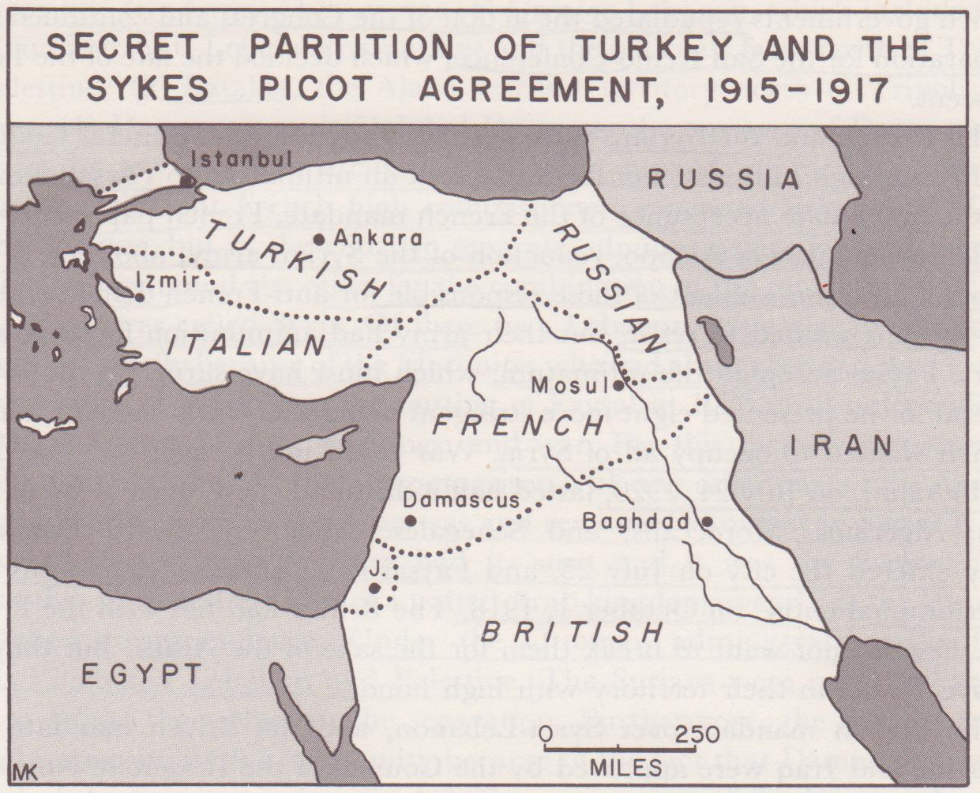

Slide 43
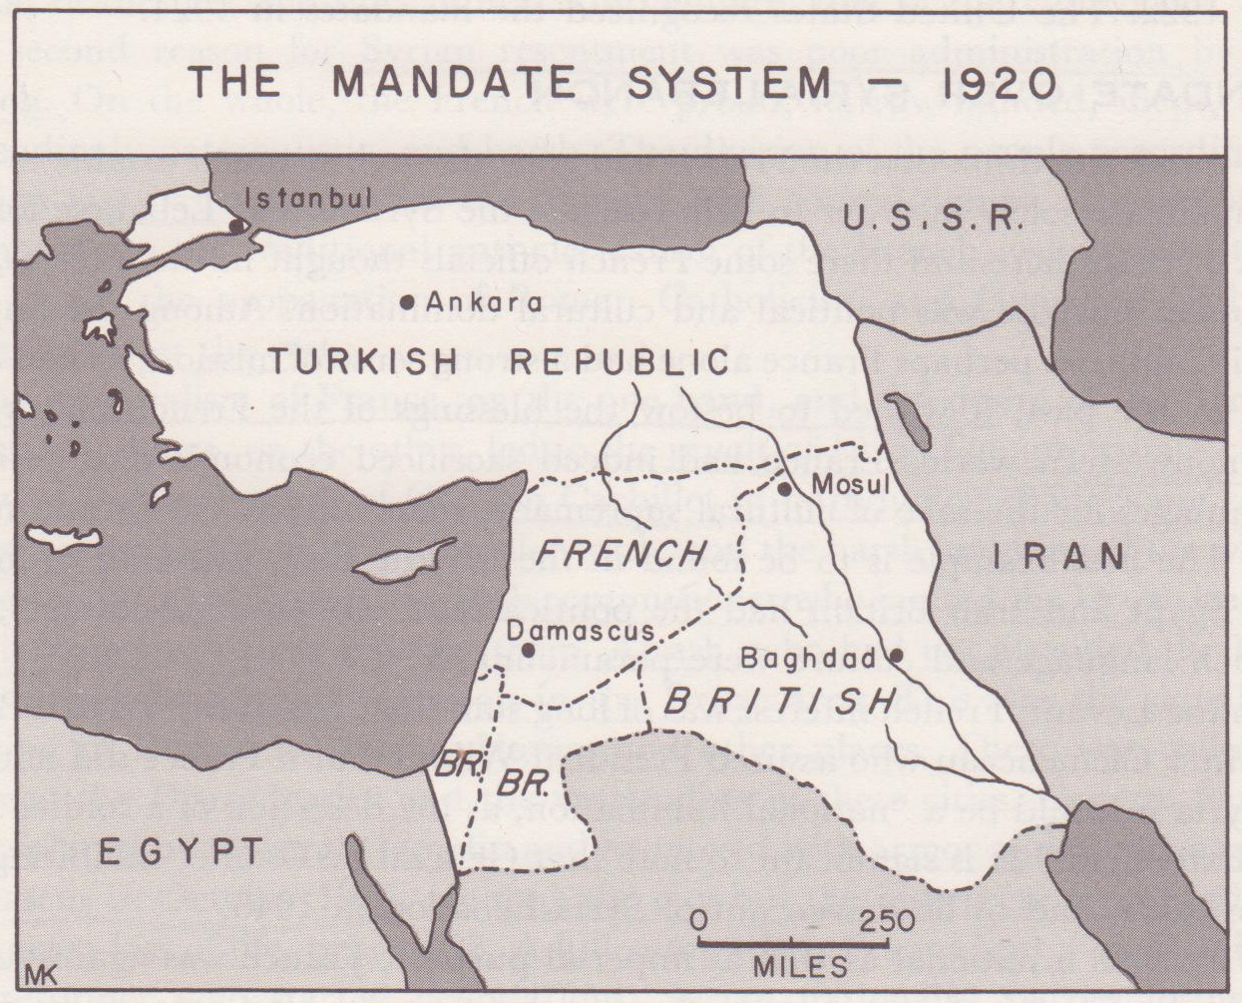

Slide 44
Treaty of Lausanne
League of Nations mandated elections, nationalists won by landslide in 1920
Kemal gathered the ulama of Anatolia and issue a counter fetwa denouncing the Shaykh al-Islam
As nationalists gathered political strength, Kemal was befriended by Bolsheviks, French and Italians much to the dismay of the British. In 1923, a conference was held in Lausanne, Switzerland
In order to secure the straits as international zone, Britain agreed to recognize Turkey as independent in exchange for Kemal’s agreement that the straits be demilitarized and internationalised under League of Nations. They signed the Treaty of Lausanne in 1923

Slide 45
Turkish Independence
Engineering social change was one of Kemal’s highest priorities.
He saw Turkey needed to be European and secular.
He dismantled Islamic law (Sharia) and replaced it with Swiss Civil Code.
He introduced a Latinized alphabet in place of the Arabic one for the written Turkish.
He instituted women’s rights, embarked in major industrialization, introduced Western dress.
His reform was visionary and extensive, but not without opposition. He succeeded because of his charismatic appeal to Turkish national pride.
Although turkey is a Muslim state it remains one in which there is a separation of secular government and religion. Turkey remains tightly connected with Europe

Slide 46
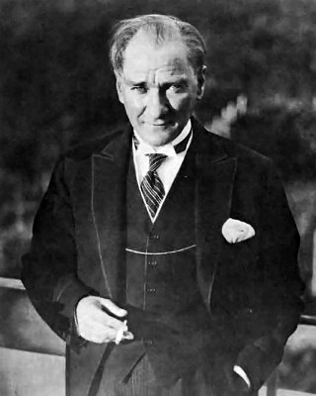
Republic of Turkey
In October of 1923, the Republic of Turkey was established on these grounds and Musatafa Kemal Ataturk became the first president
Turkey declared its neutrality in WWII
but was hard pressed by the Germans to break it. Turkish leaders deftly navigated the treacherous waters of politics and managed to keep out of the war.
In Feb 1945, they declared war on Germany and Japan in order to become a charter member of the UN and also of NATO

Slide 47
Egypt between Wars
Post WWI, Egypt was declared a British protectorate while Egyptian resentment mounted
the sultan in Egypt was Fuad from 1917
Zaghlul Pasha headed a growing nationalist movemetn and formed the Wafd Party in 1919
they had put their hopes on Wilson’s 14 points but were denied by the British to send a delegation to Paris
With the Suez at stake, British reluctant to consider independence for Egypt, came down with heavy hand
Zaghlul was exiled to Malta
Egypt erupted into riots, general strikes, burning of foreigner’s houses and killing of British soldiers would go on for more than 25 years
with no alternative, British freed Zaghlul and allowed his delegation to go to Paris, but they were to accomplish little

Slide 48
Egypt in between wars
Feeling that some compromise was necessary, the British sent a commission to study the situation
Wafd party boycotted the commission
virtually any Egyptian with political awareness was anti-British, pro-Wafd
direct negotiations with Zaghlul who represented the popular majority also failed. Once again he was exiled
With increasing violence, the British unilaterally terminated the protectorate, declaring Egypt a constitutional monarchy with Fuad as King (Ottoman “sultan” was abandoned) in Feb 1922
King Fuad promulgated constitution in 1923 with an elected Parliament. Like Britain, King Fuad could dissolve Parliament
in free elections of 1924, Wafd party won by landslide and Zaghlul was returned to Egypt to become the first Prime Minister. For the next 28 years, the Wafd party would dominate Egyptian politics
Wafd would negotiate with Britain but also lead strikes, riots and terrorist activities

Slide 49
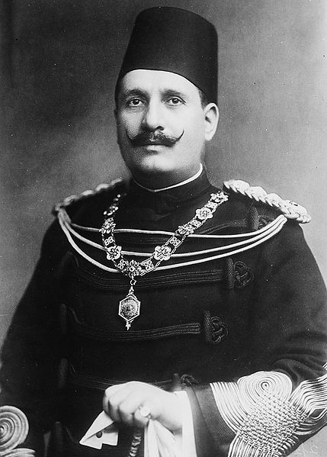
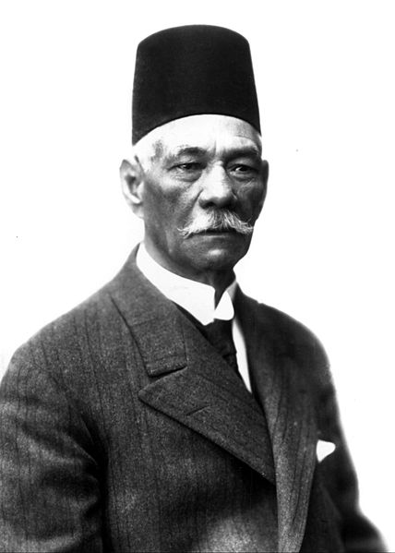
King Fuad Prime Minister Zaghlul

Slide 50
Loss of Solidarity
In 1927, Zaghlul died and the Wafd power declined
by 1936, Wafd was mellower and corruptible
Wafd remained primary opponent to the monarchy and arch rival of royalist party
Egypt fell into four political camps:
ultraconservatives of Azhar
moderate reformers of Abduh
militant Muslim groups
secularists

Slide 51
Muslim Brotherhood
Resentful of domination by a Christian nation, fear that Egypt would fall to secularization as did Turkey, there arose a revival of Pan-Islamism
22 year old school teacher Hasan al-Banna met with six others committed to the cause of Islamic resurgence in Egypt
They formed the Muslim Brotherhood, militant organization after the spirit of Wahhabi and al-Afghani. They had both missionary zeal after strict Sunni sense: supremacy of Islam and literal interpretation of Quran as law (Shari’a) and the military zeal of the Assassins

Slide 52
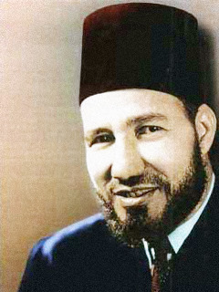
Muslim Brotherhood
Hasan al-Banna was called the Murshid al-’Am or general guide while his followers were the da’i or devotees
their headquarters in Cairo where it remained for 40 years
quite well organized, it remained secretive and underground
It worked for revival of jihad or holy war and puritan Muslim ethics
pan-Islamist, it called for military preparedness of all Muslims everywhere
“a strong army is more important than prayer or fasting”
by 1939, it had 500 branches and 500,000 members as well as paramilitary youth organizations that had secret war games

Slide 53
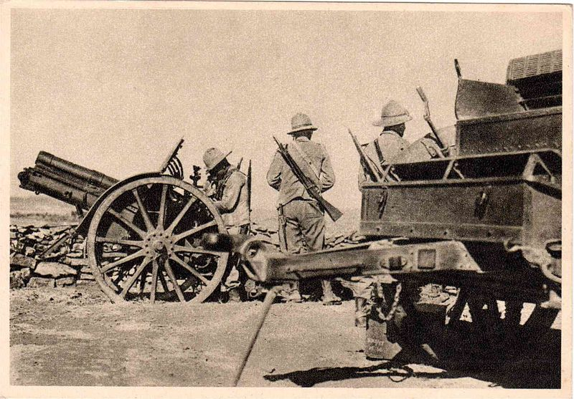
Egyptian Independence
In 1935, Italian fascist’s invasion of Ethiopia renewed fears of having continued unrest in Egypt
Britain once again entered into negotiations with the new Prime Minister and signed a treat of alliance recognizing Egypt as sovereign state in 1936
King Fuad died in 1935 and his 16 y/o son Faruq was proclaimed king
military occupation of Egypt was declared ended although Britain was allowed not more than 10,000 troops in canal zone

Slide 54
World War II Looms
Although they did not consider themselves “Arabs”, the events in Palestine to east, British imperialism impressed the younger Egyptians to end isolationism and disinterest in fertile Crescent
In 1939, 3 years after signing the Anglo-Egyptian treaty, Britain had still not removed occupation forces from Egypt as promised but rather sent more
When war broke out in September and Egypt failed to declare war on Axis powers, the British surrounded King Faruq’s palace with tanks and forced him to appoint their choice of Prime Minister

Slide 55
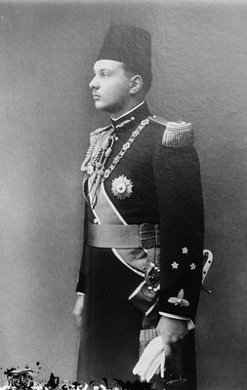
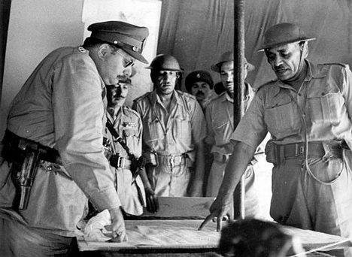
King Farouq

Slide 56
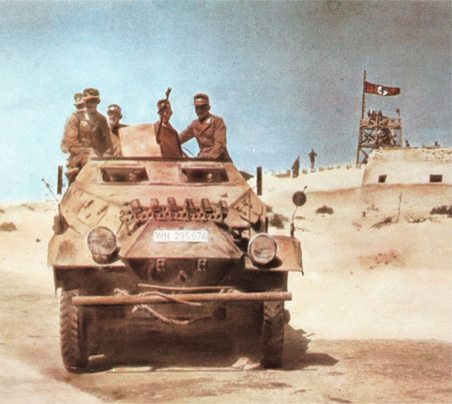
World War II
Early in the War, the Germans attempted to gain control of the Mediterranean by invading North Africa.
the famous Afrika Korps under the prestigious General Irwin Rommel invaded Libya in February 1941
British forces desperately hoped to save Egypt but under the brilliant leadership of Rommel, the Germans pushed into the border of Egypt.
German tanks were far superior to British in guns, armor and mobility

Slide 57
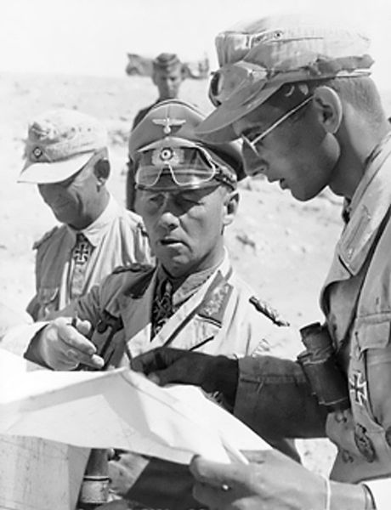
North Africa
With the entrance of America in WWII in 1942, Britain received a badly needed infusion of American tanks with heavier guns and better mobility
With the defeat of Rommel at El Alamein and successful joint US/British invasion (Operation Torch) in Nov 1942 , Allied forces pushed the Germans back to Tunisia. Rommel was forced to surrender in May 1943.
"Before Alamein we never had a victory. After Alamein, we never had a defeat.“ W Churchill

Slide 58
Egypt in WWII
Fearing germany’s advance into Egypt, Farouq cooperated with British desires
Once after El Alamein it was clear that the threat was passed, Farouq dismissed the prime minister chosen by the British and appointed the anti-Wafd leader of Sa’d party Ahmed Maher as successor.
In Feb 1945, Maher was assassinated by a young Egyptian but Sa’d remained in power
2 days later Egypt declared war on Germany and Japan and became a charter member of the UN

